Slide 1
Electric jackets By Tanya Kumari 22951A2151 Aero(3rd semester)
​

Slide 2
Electric jackets
As the name itself suggests it is a jacket which emits current continuously when switched on. It is made up of an insulating material from inside so that the user doesn’t get shock. It can be mainly used by the soldiers so that they can protect themselves from the attackers. Also it contains many additional features such as buzzer, GPS-GSM module, switch and camera.

Slide 3

Solution
.
Introducing electric safety jackets will bring a vital change as any person causing harm will get an electric shock.
Also it contains many additional features such as taser to get outer protection.
.
Emergency panic button using microcontoller.In this panic button is used for protection while emergency situation occurs.
This system helps to alert family members and people closest to the victim by using buzzer,GPS,GSM module.
The GPS module tracks the longitude and latitude to trace an exact location of a user and sends the pre-stored emergency message including location to the registered contact numbers.
.

Slide 4
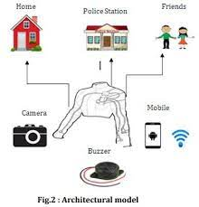
.
Raspberry pi(series of small single board computers(SBCs) )module is main part. This module has total 40 pins. 3buttons have been used. Out of that three buttons first button is used for circuit on/off. Second bottom is used for on GPS, GSM& buzzer. Third button is used for shock circuit.
Once first button is pressed that time circuit is on.
When second button is pressed that time GSM is on & GPS is also on. It sends location to predefined numbers.
We have to save three numbers that three numbers are police station, neighbor’s, and parents.
Location is send to that three numbers in the form of latitude and longitude also using GSM alert message “MY LIFE IS IN DANGER SITUATION”.
At that time also buzzer will be on .
When third button is pressed that time shock circuit will be on.
when attacker attack to a person that time shock circuit is used to injure attacker for self defence.At time camera will be on for capturing image and that capturing image is saved on memory card. Therefore it is helpful for police for searching attacker.
.
.
..

Slide 5
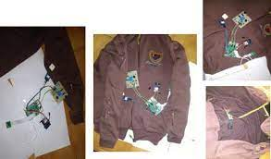

Slide 6
Prototype
.
GSM:- A GSM( global system for mobile communications) Modem Is A Wireless Modem That Works With A GSM Wireless Network .It Operates At Either The 900mhz Or 1800mhz Frequency Band . It Supports Voice Calls and Data Transfer Speeds.
GPS:- Useable In Solder-Free Breadboard Projects ready Use With Both 3.3 V And 5 V Microcontrollers
CAMERA:- In This System We Are Attaching A Camera On Jacket Which Will Capture The Image Of Culprit. So That It Will Be Easy For Police To Search The Culprit.
BUZZER:- The Alarm is designed to assist in alerting somebody in case Of emergency Situations.
.
.
.

Slide 7
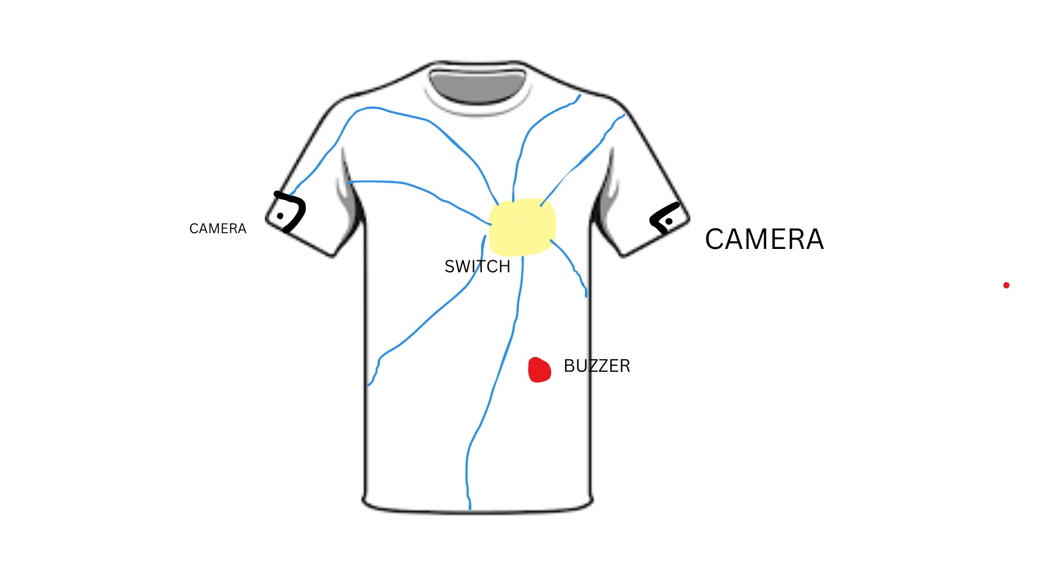

Slide 8
Rise for equality
.
Additionally, women can also go for physical combat missions, as they weren’t allowed till date. This will also be an aid to the men soldiers.

Slide 9
Future scope
Primary School Children Safety:-As the school children safety are major concerns for parents as well as school management due to the recent incidents of child crimes like children missing, abuse, kidnapping etc. This module monitors the child safety when they are travelling in school buses.

Slide 10
conclusion
The proposed design will help the soldiers when they are in danger zone. They can make rescue of themselves in danger situations. They can serve their motherland safely. This will also increase soldiers strength on borders as more and more soldiers will be able to save their lives, thereby reducing the number of deaths.

Slide 11
Thank you
Looking forward for soldiers with electric jackets on battlefield……

